Slide 1
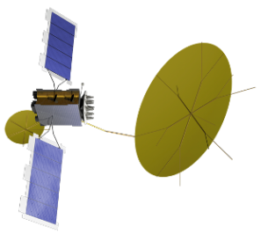
Feature Critical Path Analysis Capturing in RTC April 21, 2020
DRAFT

Slide 2
Why focus on Critical Path
A critical path is determined by identifying the longest stretch of dependent activities and measuring the time required to complete them from start to finish.-- https://en.wikipedia.org/wiki/Critical_path_method
Traditional Project Management
In the context of large and complex projects, understanding the critical path is a primary concern. Protecting the critical path is a focus to ensure the project schedule does not slip.
Agile Project Management
One of the characteristics of Agile projects frequent replanning of the work over a short time horizon, instead of detailed long term planning. Adjustments happen regularly and do not wait for the actual work accomplished to deviate very far from the plan.
Why Critical Path in MUOS
Scaled Agile supports large and complex projects over long time horizons. Features are the unit of work generally planned for one Planning Increment*, and often build on each other. They are commitments to the customer. Slipping a feature affects both our immediate credibility as well as ability to deliver on future commitments.
Identifying our CP at the Feature and PI level will provide visibility into the effects of stories and subsequently features slipping. It will help with deciding to reallocate resources or if certain slips are acceptable.
*Exceptions are PI – In Progress features.

Slide 3
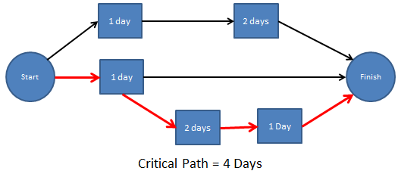
Typical Project Flow (With MUOS Terms)
OTHER STORIES
FEATURE HAND-OFF
CUSTOMER DEMO
http://acqnotes.com/subcategory/schedule-development/page/3

Slide 4
PERT Method (Activity on Node)
PERT charts are directed graphs; a dependency diagram
Arrows have no weight (AON)
The weight of the work occurs in the Story (measured in Story Points)
The arrow denotes the dependency (e.g. starting Story 2 depends on the completion of Story 1)
The arrow can be described from either node (blocks or depends on)
Depends On
Story 1
Story 2
Blocks
In RTC, the dependencies are defined with Links. The Link may be created in either story, and it will be automatically present in the other story.

Slide 5
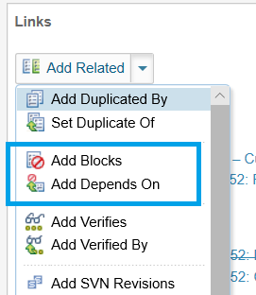
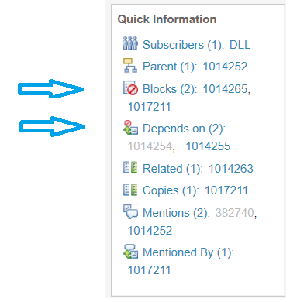
RTC Dependency Links

Slide 6
Example: Critical Path Table
Feature | 1014252[56]: Notify MFTs to perform OTA-FT following bootstrap OTA-FT (trouble ticket INC000004670352
Sprint | Story | SP | Summary
EA 15.1 | 1014255 | 3 | Feature 1014252: Create STCD and review with stakeholders
EA 15.1 | 1014257 | 3 | Feature 1014252: Perform Iterative Implementation, Integration, development Testing including updating design (Part 1)
EA 15.2 | 1014258 | 1 | Feature 1014252: MFR 1 – Dev Team Performs Cybersecurity Assessment
EA 15.2 | 1014263 | 5 | Feature 1014252: Execute STCD Feature Integration and testing including STCD updates identified
EA 15.2 | 1017211 | 5 | Feature 1014252: Perform Iterative Implementation, Integration, development Testing including updating design (Part 2)
EA 15.3 | 1014256 | 1 | Feature 1014252: Provide Deployment Notes and Operator Impact Inputs
EA 15.3 | 1014264 | 2 | Feature 1014252: Review the Site Functional Test Plan within STCD and get customer stakeholder approval
EA 15.4 | 1014265 | 1 | Feature Demo – Customer Demo Event Feature 1014252: OTA-FT
EA 15.4 | 1014266 | 1 | Feature 1014252: Initiate CM PDO Processing for all CI's
 |  | 12 SP
Blocker | Blocked | CP
1014255 | 1014257 | Y
1014255 | 1014263
1014255 | 1014264
1014255 | 1014265
1014256 | 1014265
1014257 | 1017211 | Y
1014258 | 1014265
1014263 | 1014265
1014264 | 1014265
1014265 | 1014266
1017211 | 1014265 | Y

Slide 7
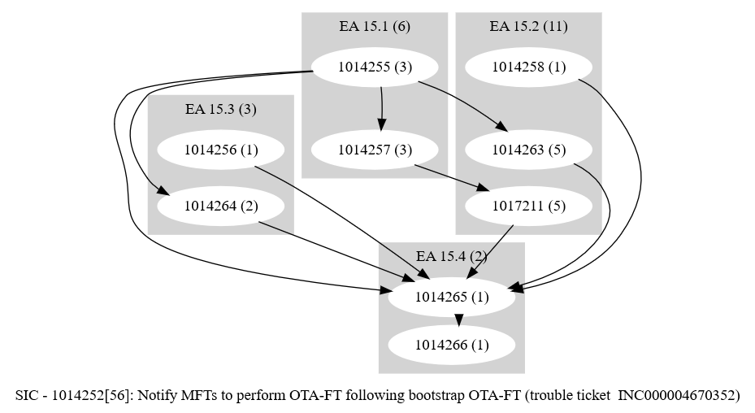
Example: Dependency Graph

Slide 8
Next Steps
Feature Owners determine dependencies for each PI 15 Feature
Feature Owners enter dependencies in RTC
Agree on format for Critical Path attachment in RTC (SM/FO)
Update all features with CP attachment (FO, SM to help)
Develop process for determining dependencies for future Pis
Continue to explore tooling to automate
.

